Slide 1
Development of VR platform for cloud-based neurorehabilitation and its application to research on sense of agency and ownership
Advanced Robotics

Slide 2
Introduction
1. The most well known and eﬀective therapy for phantom limb pain (PLP) is mirror box therapy.
2. One of the problems with such therapies is that the concrete mechanism behind the therapies has not been fully explained such as telescoping phenomenon.
3. If we identify the mechanism behind a therapy and design an algorithm to determine the appropriate movement of the virtual limbs, the situation of the clinical setting will be improved.
4. However, a major barrier to this goal is the huge cost involved in collecting the paired data of the reaction of patients and the movement of virtual limbs given to the patients.

Slide 3
Introduction
5. We propose a cloud-based immersive virtual reality system that enables us to amass a huge clinical database for neurorehabilitation.
6. Sense of agency (SoA, 涉入感) : the subjective awareness that one is initiating, executing, and controlling one’s own volitional actions.
7. Sense of ownership (SoO, 归属感) : the pre-reﬂective awareness or implicit sense that one is the owner of a movement.

Slide 4
Methods
1. Cloud-based virtual reality system
(1) Database
(2) Server
(3) Client

Slide 5
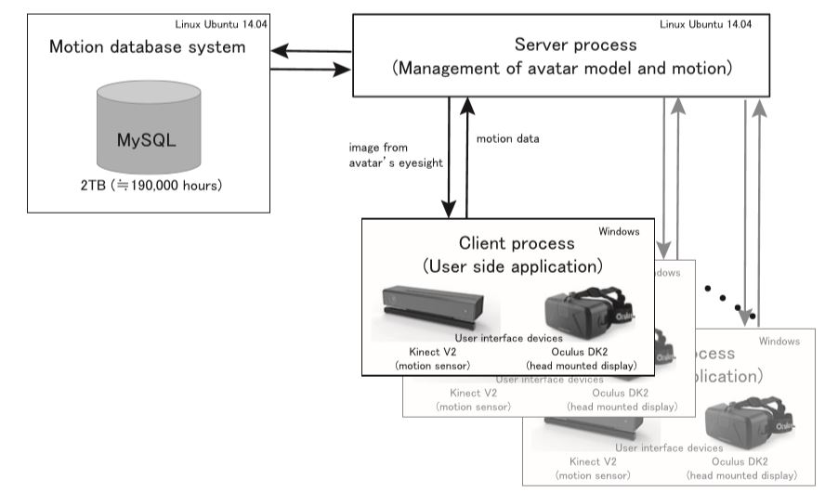

Slide 6
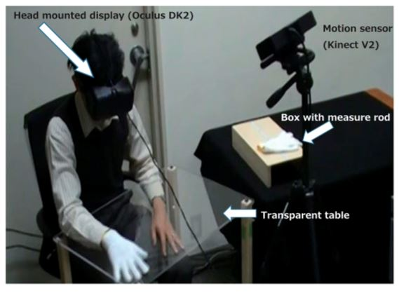
Methods
2. Participants
(1) 8 males and 4 females (Ten of them were right-handed and two of them were left-handed)
3. Hardware
(1) HMD (Oculus Rift DK2)
(2) Kinect V2

Slide 7
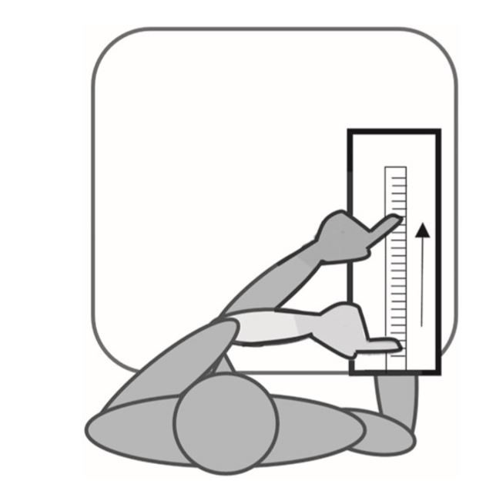
Methods
4. Experiment
(1) Turn off the HMD, and the subject points to the edge of the middle finger of the right hand using the left hand.

Slide 8
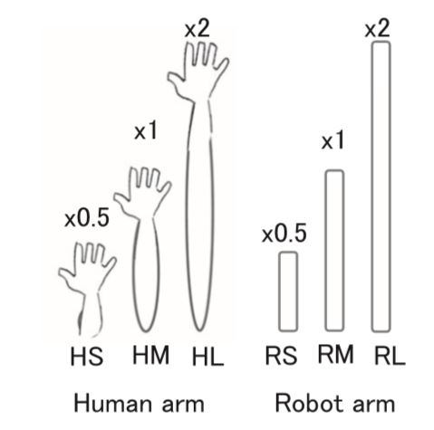
Methods
4. Experiment
(2) Modify the length of the right arm (2 appearances, 3 lengths).

Slide 9
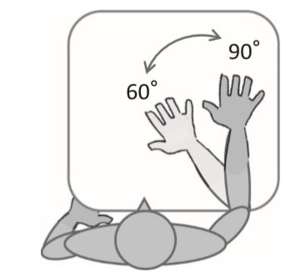
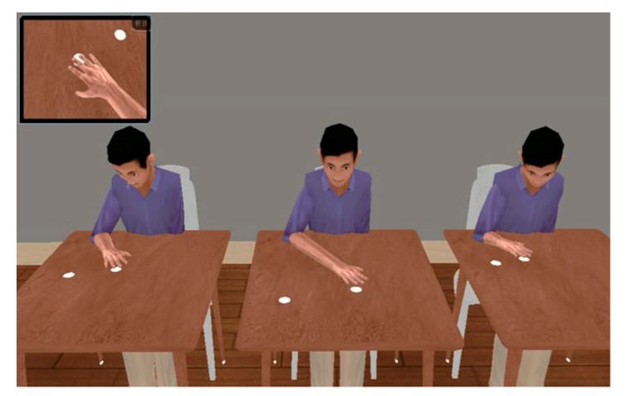
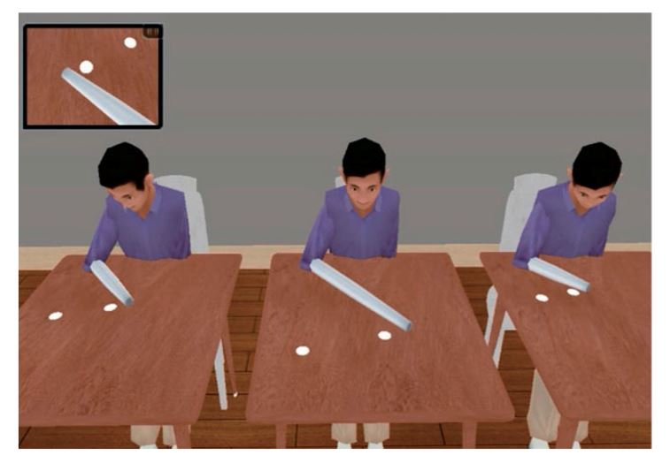
Methods
4. Experiment
(3) The participants repeat a back-and-forth movement (elbow ﬂexion-extension) of the right hand to follow the two marks for 60s in each condition.
(4) Repeat (1).

Slide 10
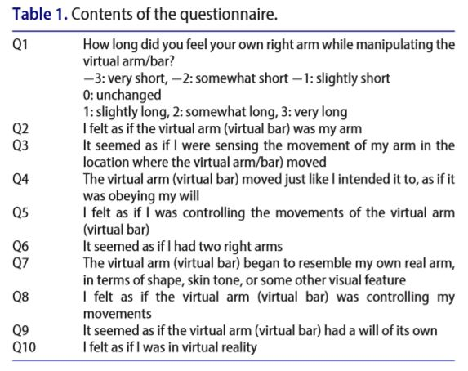
Methods
5. Questionnaire
(1) SoO (Q2 and Q3),
(2) SoA (Q4 and Q5),
(3) Control (Q6,Q7,Q8 and Q9).

Slide 11
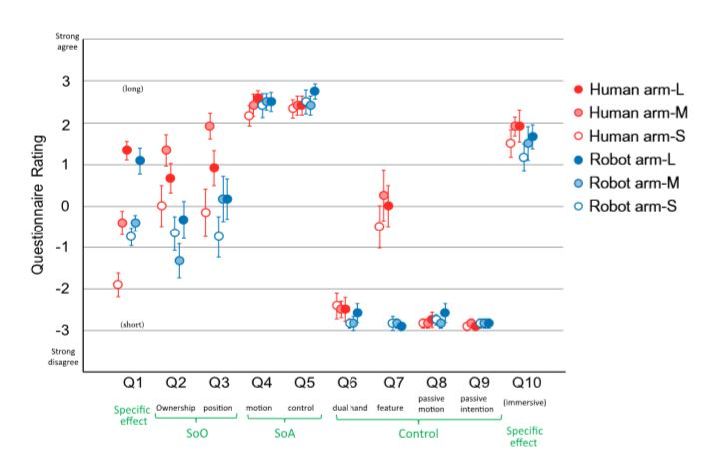

Results
1. SoO tended to be higher in the medium length condition than in other conditions.
2. SoA (>2) were obtained in all conditions.
3. The Q1 rating showed that subjective length of the actual arm became longer when long human/robot arms were displayed, while it became shorter when a short human arm was used.

Slide 12
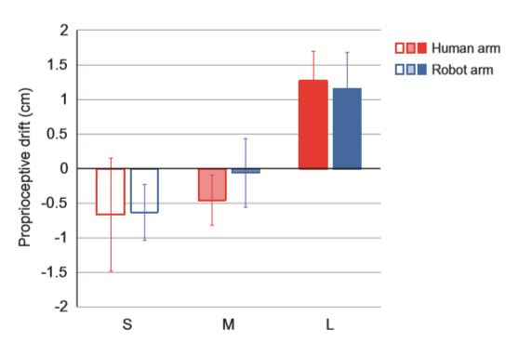
Results
4. Drifts in the long conditions(1.2±1.6cm,mean±SD) were signiﬁcantly greater than those in the short.
5. There was a moderate correlation (r = 0.33) between Q1 (subjective feeling of arm length)and drift.

Slide 13
Conclusion
1. We developed a VR platform for neurorehabilitation that changes the length of the avatar’s limb easily.
2. Through an experiment, we conﬁrmed that the change of self-body appearance of the VR avatar has enough inﬂuence on the subjective length of an arm.

